Slide 1
Formulas for Angles in Circles
Formed by Radii, Chords, Tangents, Secants

Slide 2
There are basically five circle formulas that you need to remember…..

Slide 3
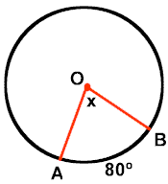
1. Central Angles
A central angle is an angle formed by two intersecting radii such that its vertex is at the center of the circle.
FORMULA
Outside arc = Inside angle

Slide 4
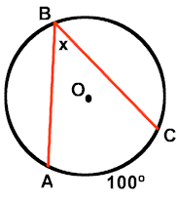
2. Inscribed Angle:
An inscribed angle is an angle with its vertex "on" the circle, formed by two intersecting chords
FORMULA
Outside arc = Inside Angle

Slide 5
Special situation
An angle inscribed in a semi-circle is a right angle.

Slide 6
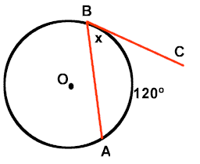
3. Tangent Chord Angle
An angle formed by an intersecting tangent and chord has its vertex "on" the circle.
Tangent Chord Angle = Intercepted Arc
m<ABC = 60º

Slide 7
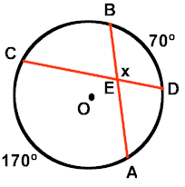
4. Angle Formed Inside of a Circle by Two Intersecting Chords
When two chords intersect "inside" a circle, two pairs of vertical angles are formed. Remember: vertical angles are equal.
FORMULA
Angle Inside = ½ the SUM of Intercepted arcs

Slide 8
5. Angle Formed Outside of a Circle by the Intersection of …..
a.) Two Tangents
b.) Two Secants
c.) Tangent and a Secant
FORMULA FOR ALL THREE OPTIONS…
Angle Formed Outside = Difference of Intercepted Arcs

Slide 9
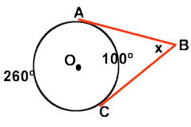
a.) Two Tangents
<ABC is formed by two tangents intersecting outside of circle O.
X = half the difference in the two measurements

Slide 10
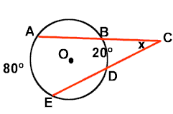
b.) Two Secants
<ACE is formed by two secants intersecting outside of circle O.
X = Half the difference in the two measurements

Slide 11
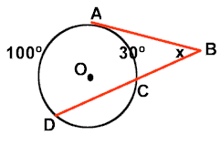
c.) Tangent and Secant
<ABD is formed by a tangent and a secant intersecting outside of circle O.
X = Half the difference in the two measurements

